Slide 1


Green Pace
Security Policy Presentation
Developer: John Elbogen

Slide 2

OVERVIEW: DEFENSE IN DEPTH
This policy defines the core security principles; C/C++ coding standards; authorization, authentication, and auditing standards; and data encryption standards. These standards will guide how the to approach defense in depth and create a secure non-vulnerable solution.

Slide 3
THREATS MATRIX
The highest priority threats should be prioritized, in order as fit.
The low priority threats, should not be disregarded, but take less precedence over priority threats.
Likely INT-030-C STR-030-C STR-002-C MEM-053-CPP OOP-052-CPP STR-038-C | Priority STR-038-C – P27 STR-002-C – P18 MEM-053-CPP – P18 OOP-052-CPP – P9 STR-030-C – P9 INT-030-C – P9
Low priority ERR-006-C – P4 ERR-051-CPP – P4 INT-035-C – P2 DCL-012-C – P1 | Unlikely DCL-012-C ERR-006-C INT-035-C

Slide 4
10 PRINCIPLES
Validate Input Data
Heed Compiler Warnings
Architect and Design for Security Policies
Keep It Simple
Default Deny
Adhere to the Principle of Least Privilege
Sanitize Data Sent to Other Systems
Practice Defense in Depth
Use Effective Quality Assurance Techniques
Adopt a Secure Coding Standard

Slide 5
CODING STANDARDS
Implement abstract data types using opaque types
Ensure that unsigned integer operations do not wrap
Do not attempt to modify string literals
Sanitize data passed to complex subsystems
Explicitly construct and destruct objects when manually managing object lifetime
Understand the termination behavior of assert() and abort()
Handle all exceptions
Do not delete a polymorphic object without a virtual destructor
Use correct integer precisions
Do not confuse narrow and wide character strings and functions

Slide 6
ENCRYPTION POLICIES
Encryption in rest - Ensure that data is encrypted when on a disk.
Encryption at flight - Ensure that data is encrypted while being transmitted.
Encryption in use - Ensure that sensitive data is encrypted at all stages

Slide 7
TRIPLE-A POLICIES
Authentication - Authentication involves confirming the right person is accessing the system.
Authorization - Authorization refers to an authenticated user’s rights and privileges.
Accounting - Accounting is monitoring activities and recording actions for compliance and security purposes.

Slide 8
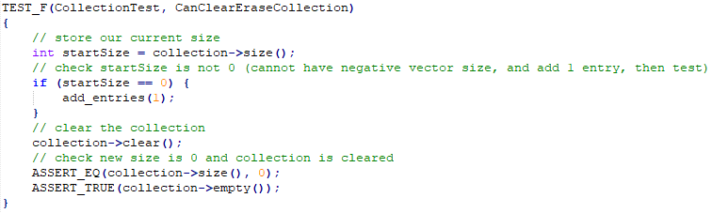
CanClearEraseCollection
Unit Tests

Slide 9
CanOutOfRangeExceptionThrow

Slide 10
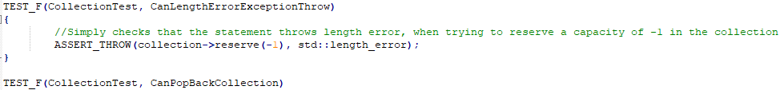
CanLengthErrorExceptionThrow

Slide 11
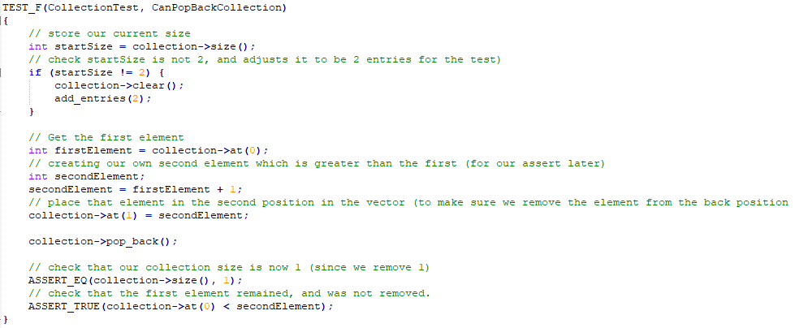
CanPopBackCollection

Slide 12

AUTOMATION SUMMARY
Automation will be used for the enforcement of and compliance to the standards defined in this policy.
Automation will enforce standards in several areas within the existing DevOps.
In the production phase, we may automate penetration tests.

Slide 13
TOOLS
The DevSecOps Pipeline refers to integrating security into your software development life cycle. ¹
Tools For Automation:
Parasoft C/C++test – Used during the design, verify/test stage in pre-production. Used during the transition/health check and maintain and stabilize stage in post-production.
LoadNinja – Used in the verify and test pre-production for stress testing. Used during the maintain and stabilize in post-production,
Logentries – Used during the monitor and detect stage in post-production, to automate information logging.
Intruder – Used during transition and health check stage of post-production to perform penetration tests.

Slide 14
RISKS AND BENEFITS
Pros
Preventative in nature
Saves money lost in the case of security issues
Early implementation is more effective and easier
Greater defense and barrier against attackers
Cons
Upfront cost
Time cost
More expertise required
Adds a layer of complexity to management and production
Conclusion: The pros of acting early and implementing security protocols plus automation far outweigh the cons. Consider an attacker successfully penetrating a security system and stealing user information. The potential loss of value in the form of trust or reimbursement exceeds any upfront cost. The time and expertise cost is trivial when it means a final deliverable of the highest quality.

Slide 15
RECOMMENDATIONS
Unaddressed concerns
Respond phase of post-production – Identification exists, but no defined action or plan has been implemented
Build phase of pre-production – In the DevSecOps pipeline, the build which selects from trusted repositories is not yet decided, and often can be crucial in the security process. From an internal perspective you can only be as secure as the tools you are utilizing.
Enforcement policies for each phase – There is not a clear standard in the policy which defines enforcement outside of tool automation. How, where, and what expertise will be implemented to ensure that policies are followed correctly and in an acceptable manner?

Slide 16
CONCLUSIONS
Keep it simple
Use correct integer precisions
Do not confuse narrow and wide character strings and functions
Handle all exceptions
Validate Input data
Default Deny
Sanitize Data
Follow and review defense in depth strategies and understand the security policy

Slide 17
REFERENCES
[1] - Foster, S. (n.d.). DevSecOps Pipeline Overview: DevSecOps Simplified. Perforce Software. https://www.perforce.com/blog/kw/devsecops-pipeline-overview#:~:text=Free%20Klocwork%20Trial-,What%20Is%20a%20DevSecOps%20Pipeline%3F,secure%20software%20faster%20and%20easier.
C++test - Check C++ and C Code for Compliance. Parasoft. (2021, June 7). https://www.parasoft.com/products/parasoft-c-ctest/.
Create and Run Load Tests in Half the Time. LoadNinja. (n.d.). https://loadninja.com/.
Log Management & Analysis Software Made Easy. Logentries. (n.d.). https://logentries.com/.
An Effortless Vulnerability Scanner. Intruder. (n.d.). https://www.intruder.io/.

